Slide 1
Welcome to the NZTwork DAO
$NZT "Net Zero Token”
$CCT “Carbon Credit Token”
$NZT
$NZT
$NZT
The Global Solution to Net Zero Decarbonization
$CCT
$NZT
$NZT
An end-to-end Decentralized Carbon Credit Generation and Indoor Environmental Data Network
$NZT
$NZT
Info Deck May 2022
$NZT
Glossary of Industry Terms and Acronyms located on Final Glossary Slide

Slide 2
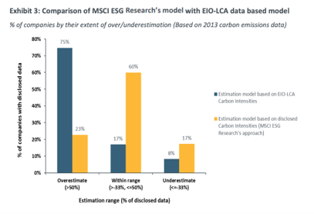
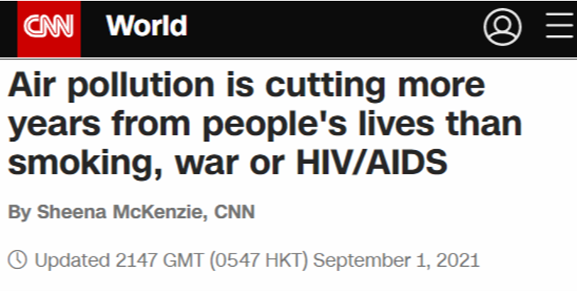
The Current Climate Problems
Climate change puts $ Trillions at risk due to increasing weather damages, migration, sea level rise, food and water: Widespread agreements to dramatically reduce carbon output, include the Paris Climate Accords and Net Zero commitments have led to an $800+ Billion carbon credit market based on completely erroneous data.
Current Net Zero climate mandates are unmeasurable and therefore unachievable: 75% of ESG reported carbon disclosures are over-estimated by >50%, with some models that are up to >600% off. Just 17% of disclosures are within range.
SOURCE: https://www.modeled.msci.com/documents/10199/139b2ab7-c95f-4f09-9d33-fdc491c5316e
Majority of ESG reports are 50%+
Over-estimated!
Air pollution and life expectancy: According to the World Health Organization, global air pollution results in 2.2 years shorter lifespan. Yet there is no wide scale solution to measure our indoor air quality.
Accurate Carbon footprint measurement rely on two key factors: data availability and data accuracy. Neither of which exist today.

Slide 3
$NZT (Net Zero Token) Solution
NZTwork is a decentralized hyper network of real-time environmental sensor data collection on blockchain. Accurately and verifiably reporting carbon use, behavioral savings, efficiency, efficacy, health and wellbeing.
The Roadmap
Raise $17.5M in token pre-sales to finish product and launch $NZTwork
Generate data that is valuable to industry such as utilities, ESG, healthcare, insurance and smart cities
Create algorithms, certified carbon credits, near real-time data collection and 2-way AI enabled automation
$NZT
Create user incentives and mining rewards to rapidly populate hyper-scale network coverage and data production
Create behavioral reductions, reducing CO2 emissions, generating $CCT certified carbon credits
Create first decentralized Edge data storage network with IoT blockchain

Slide 4
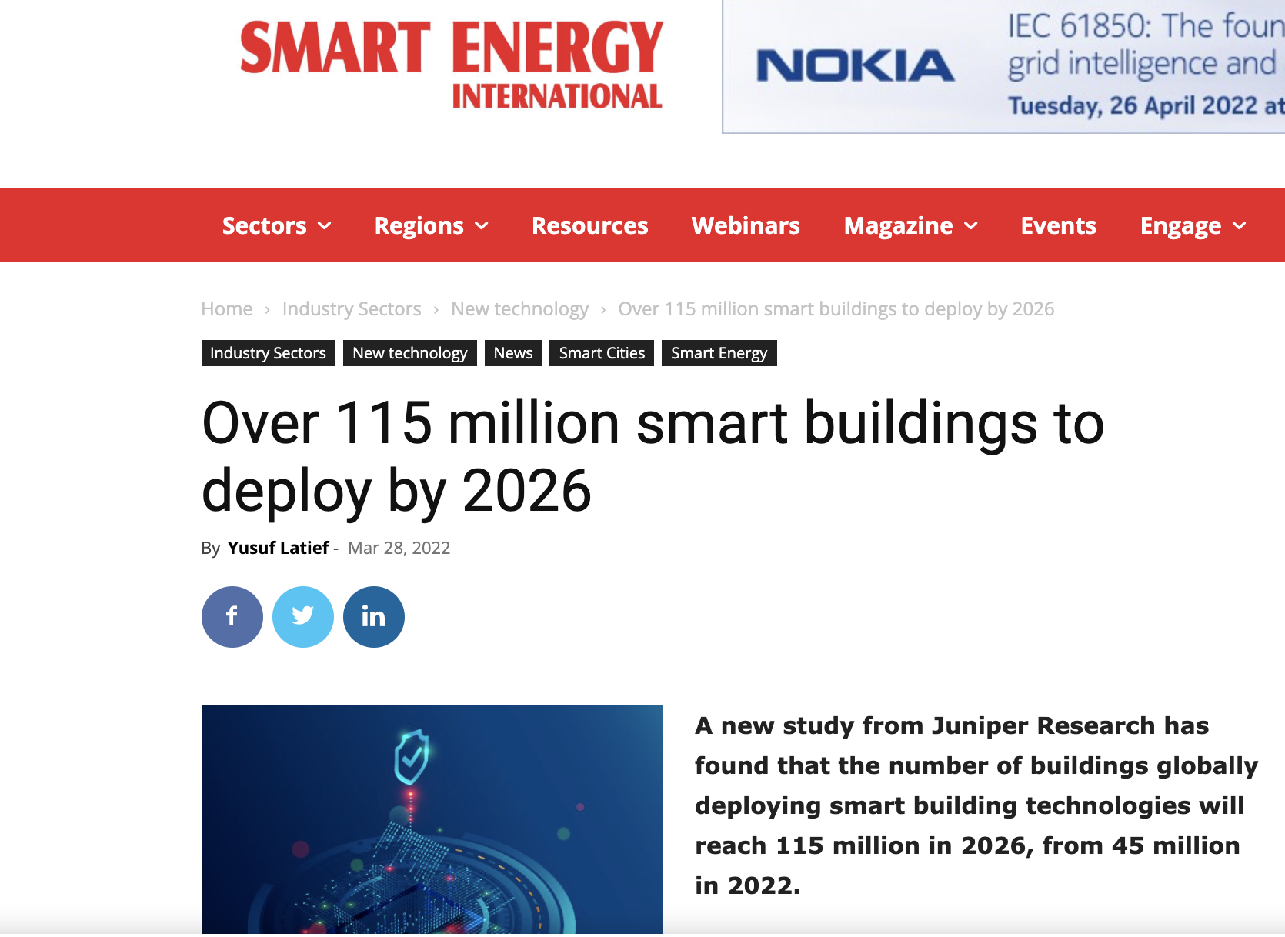
Market Size
To accelerate Carbon Mitigation, NZT creates financial incentives for stakeholders to save energy, money, and make money through the deployment of distributed intelligent edge networks worldwide.
Global Carbon markets grew 164% in 2021 to $851 Billion
Global smart home market will grow between 2022 and 2026 by almost 400% to $200B
SOURCE: https://carboncredits.com/global-carbon-market-value-soars-to-851-billion-in-2021/#:~:text=According%20to%20analysts%20at%20Refinitiv,world's%20most%20established%20carbon%20market.
Smart building sensor shipments will grow between 2022 and 2026 by 200%+ to 1B+ units annually or $150B
Nest Labs study (2015): with smart monitoring, average household can save 10-12% on heating costs and 15% on cooling costs
$800B+ in energy value is wasted annually in the EU from lack of real-time heating and cooling data or control ​
Carbon markets, Utilities, service providers currently do not have access to real-time data ​

Slide 5
Foundation for the Carbon Economy Services Platform
NZTwork creates a platform enabling entire ecosystems of consumer participants and business service providers to build applications convertible to Carbon Credits (as $CCT) or used for an anonymous, but contextual management of civilization. NZTwork provides accesss to 3-Dimensional Data to populate digital twins of the Earth, metaverses and enables a foundation to improve society in real-time.
Business and Consumer Application Ecosystem built on the NZT Contextual Services Platforms Platform
4
v
v
v
v
v
Corporate Carbon Credits
Utilities/ Demand Response
Risk Management
Public Health/ Air Quality
ESCO/Energy Management
CO2
3
Visualization, AR/VR and Metaverse
Consumers
Business Services and Data Aggregators
Trade Ally Contractors/Service providers aggregate commercial, industrial and government customers with FIAT based agreements
3D environments provide users with visually immersive awareness of data
Users participate directly to earn cryptocurrency
NZTwork Blockchain Contextual Services Platform
2
Distributed Data Exchange Layer
NZTwork API provides access to distributed database records via smart smart contracts in exchange for $NZT token payments
1
NZTwork Database Layer
NZTwork distributed database stores geographically organized IoT device data operated by NZTwork participants in Edge Nodes

Slide 6

What Makes NZTwork Unique?
Disrupting the world of environmental monitoring:
Granular
Accurate
Real-time
Privacy
Fully Decentralized
Enables real-world output, carbon credit generation:
Measured Carbon reduction
Incentivizes reduction of carbon footprint
Multiple income streams + customer savings
Benefits to both Consumers and Businesses
Bridges crypto, blockchain, consumers and business with the carbon economy
Existing commercially applied hardware provides fast market entry:
Uses existing proven Conectric technology
Developed under US DoD and CA Energy Commission project funding
All patents and production licensed
The NZTwork team produced the first live IoT sensor data exchange for crypto tokens with Hdac Technology in 2018
Exponential demand for granular data from real-world institutions:
Utilities
Corporate ESG
Healthcare
Insurance
Smart Cities
Independent and autonomous network of hardware devices:
Independent and decentralized
Works globally without licensing, regulation or coordination
Edge Nodes and Hubs synced over LTE/5G eSIM network

Slide 7
The NZT Token Explained
Introducing a 2 token model
Token integration
Node validators (Edge GW operators) can stake $NZT to have full earning potential with their hardware units. Data miners will receive rewards in both $CCT (for reducing CO2) and $NZT (for environmental data sharing). Tokens will be bought and sold via the Data Exchange (Decentralized Exchange automated on Edge Gateways and not under centralized control).
01
Carbon Credits Token ($CCT Stablecoin) Realtime carbon credits are generated based on NZTwork user energy savings and placed on the blockchain acting as "stable coin" pegged to a basket of global carbon credits markets. Initial market focus will be to issue carbon credits for other blockchain projects that want to go "net zero" and build the ecosystem around a clean, renewable crypto world.
Price stabilization
To support the $NZT token price, the hardware unit’s current income is partially based on what % of tokens is retained. $CCT are freely tradeable and will not impact earning potential.
02
NZT Governance tokens ($NZT Floating coin) Reward for transporting, storing, and collecting environmental data from real-time indoor sensor networks, with floating value and can be exchanged for $CCT.
Data collection as a platform
Collected data will be used individually by data miners to change behavior and reduce carbon, earning $CCT. The distributed server network will also be used as a platform to build services for specific markets, verticals, aggregation, end uses, and business models around energy, carbon and contextual data. This includes visualization tools, 3D and metaverse integrations!

Slide 8
Value of $CCT Carbon Credit Stablecoin
The $CCT carbon credit is highly differentiated from other existing carbon credits as it is “mined” directly from the attributable source. The minting of a $CCT carbon credit is based on actual, real-time measurement, using energy regulator and utility approved “metered savings” software. $CCT carbon credit crypto tokens can be earned or split fractionally, making them easy to earn and trade.
Voluntary carbon credits value around $10/ton
Certified compliance credits value around $100+/ton
$CCT will command the highest value as the only directly measured credit
The value of 1 $CCT = 1 ton of carbon avoided. It is convertible from kWh or BTU measured using NZTwork sensors.
Voluntary Carbon Markets
Compliance Carbon Markets
1. Operators of NZTwork IoT sensors begin earning $CCT automatically after their behavioral consumption is recorded.
2. If consumption is reduced or in the case of solar PV, EV or battery banks production avoids CO2 then $CCT is automatically minted and deposited to the user wallet.
3. Users can keep their $CCT to claim carbon reduction on ESG reporting, can sell $CCT to a carbon broker or exchange, or can convert it to $NZT in case they want to capture value gains.
The initial target audience for NZTwork will be to get crypto investors, projects and miners to directly acquire $CCT in order to promote a Net Zero crypto ecosystem. and resolve Public Relations issues within the industry.
Other commercial entities and major carbon consumers can also purchase $CCT to voluntarily offset emissions.
“Cap and Trade” compliance markets allow industrial carbon emitters like utilities to operate. They are required to offset carbon emissions with certified carbon credits. Existing carbon capture projects simply cannot fill the demand or have an exorbitant cost to implement. NZTwork changes the game by avoiding the carbon use in the first place.

Slide 9
Sustainability for Blockchain Ecosystem
The blockchain and crypto ecosystems have a difficult time justifying high carbon intensities to operate networks. NZTwork is the solution they have been waiting for!
Carbon Credits Token ($CCT) is the first real-time carbon offsetting platform for the blockchain ecosystem, that can be acquired via decentralized exchanges (DEX) and allow crypto projects to go Net Zero!
Carbon offsetting projects certification: Projects can buy $CCT though the CO2 reducing network to offset environmental impacts. We aim to make the blockchain industry Net Zero carbon free!
API for voluntary carbon offsetting
Target market
1. Individuals can donate $CCT to their favorite Crypto projects.
2. Investors and crypto project operators can buy $CCT to hedge future carbon reduction demands and cost mitigation.
The NZTwork API will allow crypto projects, where users can choose to offset 0-100% (to increase user participation) of their carbon emissions integrated via API with crypto wallets, decentralized and centralized exchanges.
Crypto investors, operators and mining companies who can now offset the CO2 production of all their crypto portfolios (for ESG reporting). All other companies that want a transparent and decentralized carbon offsetting. Aggregation services will bridge the crypto platform with compliance markets and large-scale industrial companies that require carbon offsets.

Slide 10
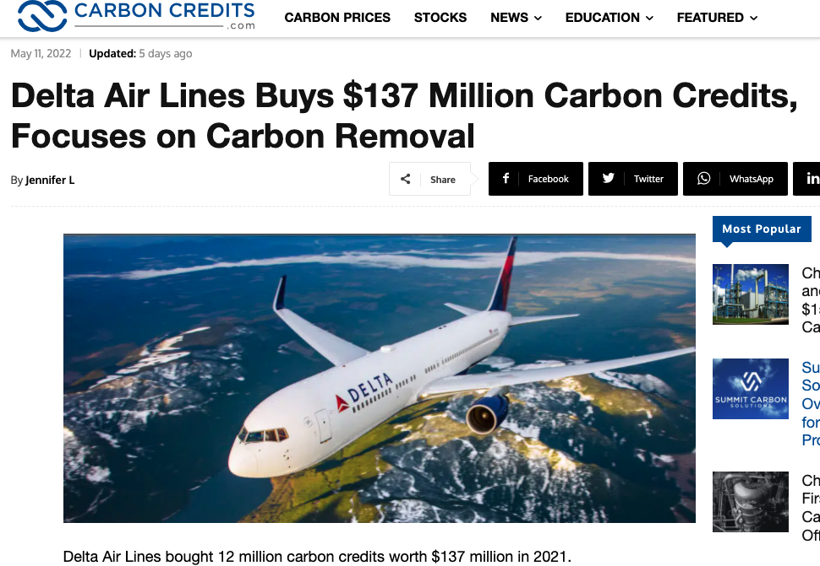
Unique Carbon Reduction Incentives
Participants are incentivized by an increase in the value of $CCT Carbon Credit Tokens (estimated to increase up to 30x value over the next 5 years) or $NZT. This provides strong economic reasons to participate and save more! Initial target will be to sell credits to blockchain ecosystem projects, which want to go “net zero” and can pay for $CCT in crypto tokens. $CCT will also be sold through compliance markets.
“Stablecoin” Pool of $CCT and Carbon Credits
1
Blockchain projects buy credits to go Net Zero, creating demand for credits and $CCT
$CCT
Carbon Credit
NZTwork participants issued $CCT for reducing carbon use, generating a carbon credit
Carbon credits issued for reduced carbon use based on NZTwork blockchain data
$NZT
$CCT
$CCT holders may exchange for $NZT, creating demand for $NZT and providing them financial rewards. $NZT holders may exchange for $CCT creating demand for carbon credits
A small transaction fee from $NZT exchanges will be used to build up treasury reserves for the purchase of additional credits and liquidity
2
Industrial Users and Smart Cities buy credits to offset emissions creating demand for credits and $CCT

Slide 11
Mining and Minting a Certified Carbon Credit
NZTwork consumer App users are guided how to save energy use with real-time data from their IoT sensors.
Regulator and utility approved “metered savings” provides real-time Measurement and Verification (M&V) of savings using 3rd party software
1
6
2
Certified “Trade Ally” install contractors and ESCO’s (“channels”) install NZTwork sensors (w/self-install option)
7
Metered Savings/Production are converted to Carbon value based on current grid energy conditions
Users connect new or existing PV solar panels to track production and carbon mitigation
When metered Carbon reduction is recorded, $CCT is automatically minted, and deposited into the user or service providers wallet
3
8
4
Sensors installed on ECM’s including Variable Frequency Drives (VFD’s), Heat Pumps, or whole buildings
9
$CCT can be audited automatically by 3rd parties as it is on-chain, will be the highest value Carbon Credit available
5
Additional environmental sensors & controls installed to provide AI based automation/2-way control
10
Carbon Credits can be shared by aggregators and channels with commercial and industrial customers, without exposing them to cryptocurrency or having to invest anything into carbon credit mining!

Slide 12
The NZT Components Stack
NZT Platform
IoT Platform & HW
Hybrid Blockchain Ledger
Edge Node Graph Database
Hubs
User App
Token Wallet
Syncs local/remote data
LTE/5G Cellular backhaul
Source for data package minting
Wi-Fi/LAN Access Point
Bluetooth AP for P2P
NZT Wireless Mesh
LTE/5G Cellular
RPi Platform
Device Registration
GPS Coordinates
Bluetooth AP
Realtime monitoring & alerting
Token Wallet
Social P2P when connected to AP
iOS/Android
Data Mint (NFT)
DEX Data Exchange/API
Echo Routers
Data Miners
NZT Wireless Mesh
Bluetooth Access Point (AP)
NZT Wireless Mesh Sensors
5V USB, Bluetooth and battery versions
All necessary technologies are available as Open Source or under exclusive licensing arrangements, with an extensive developer pool to build them out into the production HW and SW.

Slide 13
The NZT Network Architecture
NZT facilitates Smart Transactions between data seller and buyer, AI, services and data customers
Data Miners & Sellers
Data Users & Buyers
NZT mesh network
Internet/LTE
Users
Utilities
CO2/air quality
Temp/ Humidity
AI
Healthcare
Occupancy
Window
DApps/Apps
Insurance
Thermostats/Actuators
Carbon Markets/Crypto Exchanges
Smart Cities
Energy
Sensor
(Data Miner Pool)
$100-$500 ea.
Mesh Router
(Infrastructure Pool)
<$100 ea.
Hubs
(Infrastructure Pool)
<$600 ea.
Full Blockchain Nodes (Infrastructure Pool)
<$2,700 ea.
Data Services (Dev Pool)
Data Customers
NZT Tokens
Real-time Data

Slide 14
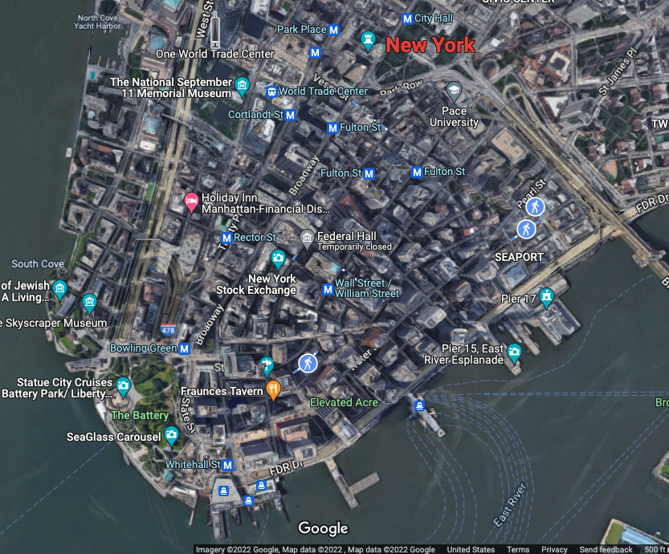

Creating a Network of Smart Data
First mover in real-time environmental smart data collection on a large scale.
Installation of Full Nodes secures blockchain
Data is key for measurement and decision-making.
Install Hubs and forwards traffic to Nodes over cellular internet
Install mesh routers and register GPS location to build coverage to hubs
Need for more comparative and larger data sets as most compiled data is widely dispersed.
Install data miner sensors and data miners where coverage exists
Nearly unlimited, regulation free real-time scalability.
Data available to users on App directly, and customers in marketplace, searchable by unique device address or nearest router coordinates

Slide 15






NZTwork Team
Nicolas Waern
Phillip Kopp
“X” Xuezhi Hu
Nicholas Lee
Vince Broyles
Digitalization Expert
IoT & Wireless HW expert
Marketing & Crypto expert
Industry 4.0/5.0 Expert
IoT Blockchain Product Expert
CEO WINNIIO industrial digitalization consultancy,
Digital Twin Thought Leader CTO, CSO, CXO, Co-chair Digital Twin Consortium, Metaverse, AI, change management, IoT and smart cities & buildings strategy consultant.
Tech co-founder with 22 years experience as, CEO Conectric Networks, President Cloudbeds (Softbank Vision Series D), COO Energy Eye (Acqd’ Somfy Group), funded via California Energy Commission and US DoD. Written 15+ patents.
Digital marketing consultant, online domains trader, local SEO course creator and mostly known as a CTR SEO expert. Blockchain/crypto technology & market expert. As a student, also active as environmental activist.
Advisor with over 30 years experience in product development, management, and sales in the industrial, IoT, IT and security fields for market leaders including Hyosung and Total Soft Bank, President of Accessworks (DBA Techsphere).
Advisor with nearly 30 years experience as a software engineer, analyst, product manager, CTO and VP sales & marketing in defense, telecom, VR, web3 and startups incl. L3, BAE, Raytheon and Qualcomm.
University of St. Gallen (Switzerland) & Yonsei University (South Korea). BsC, Jönköping International Business School, Master IT Management, University of Gothenburg (Sweden).
International Business, Finance & Strategic Management, Alliant International University & United States International University.
Business Economics, Master Investment Analysis, Tilburg University (Netherlands).
Mechanical Engineering University of Maryland.
Computer Science, Law and MA Industrial Engineering Management National University.

Slide 16





NZTwork Advisor Board and Council
Corban Lester
Leader ?
Leader ?
Leader ?
Leader?
Energy & Sustainability Advisor
Award-winning corporate energy efficiency and sustainability leader.
Energy engineering, program management. Lockheed Martin, Nike, The Green Grid Association, Southern California Edison, National Grid, Energy Trust of Oregon and Ameresco.
Blockchain and crypto- currency market thought leader and influencer
Global Carbon commodities and futures exchange market executive
Energy and Utilities, ISO, and Regulatory Executive
NGO, Politician and Clean Energy Economy Leader

Slide 17
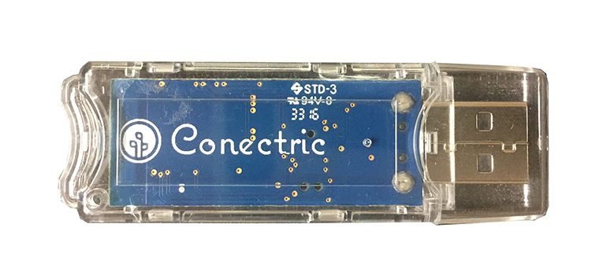
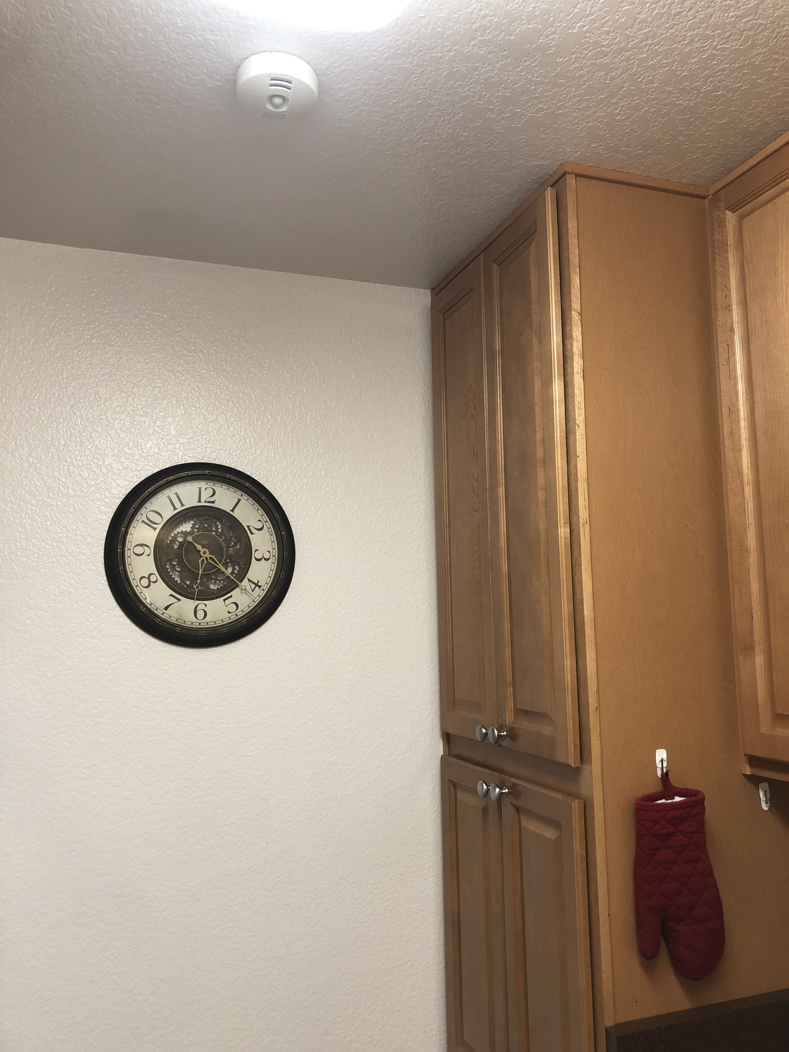
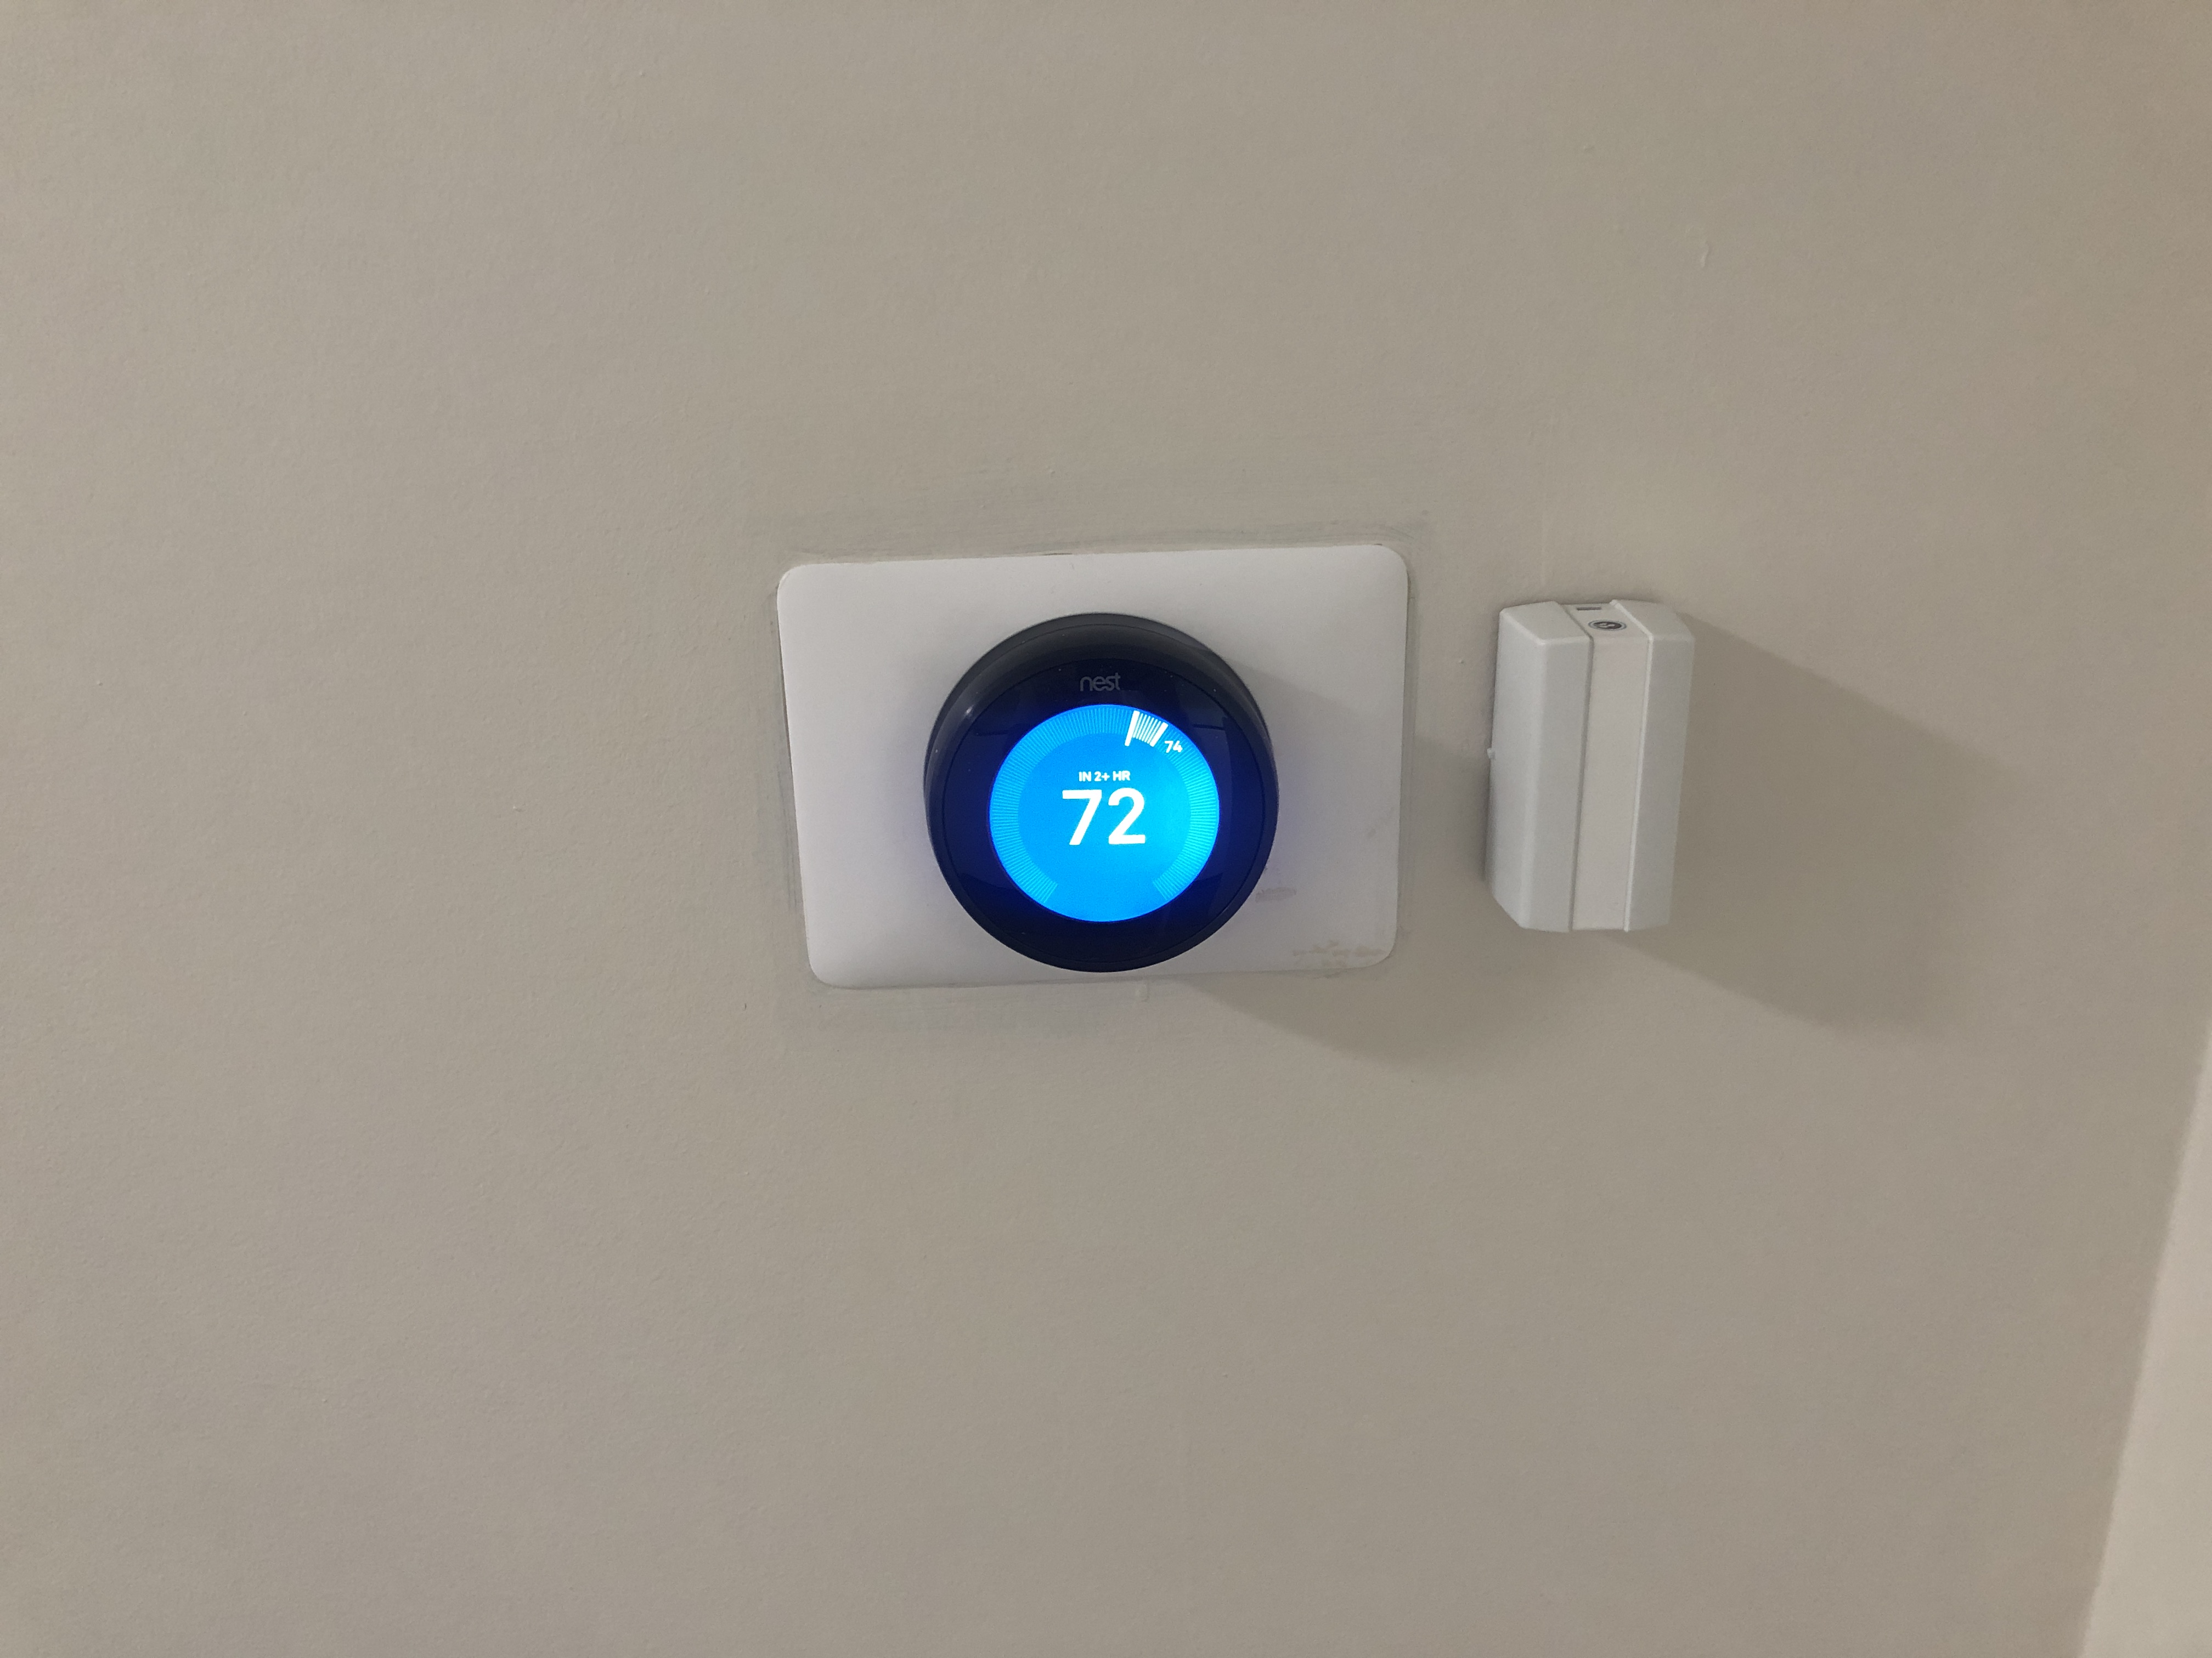

The NZT Technology Overview
Existing and tested device prototypes are nearly ready for mass production. The NZT tech will be licensed through Conectric Networks and can be ready for mass consumer use within <9 months and optimized for chip supply chain.
All hardware unit production agreements are controlled by NZT, minimizing availability or operation risks. The NZT network is not controlled by NZT or relies on any third-party servers or clouds. The entire network and data is 100% edge/distributed. Should any market vendor go out of operation, all existing network will continue operating in perpetuity and is completely autonomous.
Similar solutions which we have improved upon
Helium and MXC networks are dependent on LoRaWan networks in each country maintained by different companies and are highly regulated, with many networks facing saturation and relying on centralized operators with solvency issues.
Planetwatch uses external centralized server networks from its hardware producers that connects to its network. If those servers go down, or their "business agreements" are not adhered to, the network goes down.
We uniquely have 99.9999% reliable, 100% autonomous, 100% private real-time serverless networks, which have zero internet or regulatory dependency.

Slide 18
User Experience
1
User downloads NZTwork App creates Wallet ID
6
Users are prompted to buy Data Miners and Carbon meters ($100-$500/3-12 mo. ROI)
CO2/
air quality
2
User checks network coverage and is recommended equipment
7
User receives devices and pairs to app using simple 1-step UUID QR code activation
3
Users acquire $NZT on exchange (DEX) to purchase network and mining equipment
8
User receives $NZT rewards for connected devices producing data and coverage
4
Early adopters buy Edge Nodes to establish robust blockchain ($2,700/12 mo. ROI)
9
$NZT rewards can be used to purchase more equipment, traded for $CCT carbon credits or sold on exchanges
5
Users are prompted to buy Hubs and Routers and expand coverage ($100-$300/3-6 mo. ROI)
10
Behavioral changes that lead to reduced energy consumption or clean energy production earn $CCT carbon credit awards

Slide 19
Comparing to other Carbon Credit Networks
We are the only ”cradle to grave” measurable production of carbon credits based on avoided carbon use.
NZTwork creates the highest quality carbon credits measured and auditable from the point of origination. Whereas other carbon credit networks are brokering 3rd party projects or investments which could lead to gaps in reliability, traceability and transparency.
Network | Carbon Offset Type | Measured | Type | Production/Scalability | Region | Value p/Credit
NZT | Avoided Energy Use / Renewable Production | YES | Voluntary or Certified | Any Consumer or Business Worldwide | Global | $10-$100+
Nori | Farmland Sequestration | Estimated | Voluntary | Farmer | USA | $15
Flow | Forest Preservation | N/A | Voluntary | Landowner | N/A | $5-$30
Moss | Forest Preservation | Audited | Certified | Landowner | Brazil | $7

Slide 20
Comparing to Other IoT Networks
Strong adoption will be encouraged, especially from passive income seekers who operate Miners at a profit. At the same time, it will give users real-time info to improve their living conditions and increase health and life expectancy.
Comparison to other networks, the number of miners/gateways, and the cost of each unit in their network:
Network | Miners | Monthly Growth Miners | Price/ Miner | Avg. Payback Rate | Manufacturer | Network
NZT | 10.5M¹ | 175,000² | $100¹-$2,700³ | 3-12 months | NZT HW Foundry or 3rd party External | NZT 100% Distributed and Autonomous
Helium | 703,784 | 80,000 | $600 | 24 months-10 years* | External | LoRaWan
MXC | 23,729 | 1,000 | $3,000 | 10 months | Internal | LoRaWan / LPWAN
Planetwatch* | 67,078 | 3,000 | $350-$2,700 + annual license fee | 30 months-15 years* | External | Manufacturer’s centralized servers
*All Planetwatch Awair miners are no longer receiving income due to a vendor disagreement. In large cities Helium miners have up to 10 years payback due to LoRaWAN saturation.
NZT is designed to prevent this! ​
¹ NZT projects 10.5M data miners deployed within 5 years at a cost of <$100 ea., much lower cost than other solutions.
² NZT projects an average monthly growth of 175K miners over 5 years
³ NZT Node Gateways (<$2,700) provide edge compute, storage, blockchain node, validation and are connected over LTE cellular with 5 years eSIM service included.

Slide 21
Comparing to other Decentralized Storage Networks
We are the first fully decentralized storage network that gives storage providers income distribution.
The NZTwork storage network will be decentralized, trustworthy and different, where any new storage provider entrant has the same hardware and the same income chances as any other provider. Costs and rewards are integrated into the ecosystem.
Network | Min. Hardware Investment | Min. Staking | Storage Usage Rate | Monthly Electricity Costs | Storage Costs | Income Base
NZT | $2,700 | 0 | high | $10-20 | NZT | Integral part of the network
Filecoin | $15,000 | $15,000 of FIL tokens | very low | $150-300 | Low/ FIL * | Existing storage reputation
Storj | $100+ but need PC | 0 | extremely low | $30-150 | Low / $ | Existing storage reputation
Sia | $100+ but need PC | 0 | extremely low | $30-150 | Low / $ | Existing storage reputation
*With Filecoin network the storage costs are denominated in their token price, so future costs are unknown and volatile.

Slide 22

Roadmap & Use of Proceeds ($17.5M)
2022
2023
2024
2025
2027
June
August
October
December
Global expansion into all certified compliance carbon markets
465,000km coverage with 12M+ data miners and 1M+ Nodes hardware units (compare to Helium network 700,000 gateway miners sold in approximately
<2 years)
First funding rounds + PoC + Engineering Hardware (HW) + Software (SW)
Strategic round from influencers, VCs and bigger pool groups + Alpha Release Prototype HW and SW, Key Market Trade Ally Registration
IDOs on launchpads / IEOs on CEX + Public launch + HW presale ongoing
Shipping Data Miner HW to consumers, first data sales to utilities and service providers on DEX, start marketing campaigns in USA + Europe + China
July
September
November/December
Users begin to generate $CCT, Expand in USA, Europe, and China before growing more elsewhere + NZT Ecosystem development incl. NFT and data marketplace
Full network coverage and compliance market participation in key regions
Seed round for ecosystem funds and top VCs + Engineering HW + SW
Presale round from pool groups + Beta Launch (public trial use) + Key Market HW presale open, Trade Ally Training
Shipping Node GW to consumers
Use of Proceeds
10%
45%
15%
20%
20%
Admin
/Overhead
Payroll & Ecosystem
R&D
Marketing
Legal & Accounting

Slide 23
Token Distribution
Total Initial Project Funding | $17,500,000
Total Token Supply | 1,000,000,000
 | Token Allocation (%) | Tokens Allocated (#) | Project Funding | Token Price | Full Diluted Valuation | Cliff | Vesting | % Tokens Released at TGE
Supporter Allocations | 20% | 200,000,000 | $17,500,000
Angel & Seed Supporters | 7.0% | 70,000,000 | $2,450,000 | $0.0350 | $35,000,000 | 3 months | 3 years linear
Strategic Supporters | 7.0% | 70,000,000 | $5,670,000 | $0.0810 | $81,000,000 | 3 months | 2 years linear
Private Supporters | 5.5% | 55,000,000 | $7,810,000 | $0.1420 | $142,000,000 | 1 month | 2 years linear
Public Supporter Sale | 0.5% | 5,000,000 | $1,570,000 | $0.3140 | $314,000,000 | immediate |  | 0.50%
Ecosystem and Rewards | 50% | 500,000,000 |  |  |  |  | 50y, every 2y halving
Network Pool (mined) | 15% | 150,000,000 |  |  |  |  | 50y, every 2y halving
Miner Pool (mined) | 25% | 250,000,000 |  |  |  |  | 50y, every 2y halving
Developer Pool | 10% | 100,000,000 |  |  |  |  | 50y, every 2y halving
Airdrops | 2% | 20,000,000 |  |  |  | 1 month | 6 months linear
Marketing | 5% | 50,000,000 |  |  |  | 2 months | 3 years linear
Exchange Liquidity | 8% | 80,000,000 |  |  |  | immediate |  | 8.00%
Team and Advisors | 15% | 150,000,000 |  |  |  | 3 months | 3 years linear
TOTAL | 100% | 1,000,000,000 | $17,500,000 |  |  |  |  | 8.50%
Initial circulating token supply | 85,000,000
Initial market capitalization $ | $26,690,000
Token Design
Early project supporters can buy NZT for $0.035 ea., with September public sale at $0.314 ea.
7%
5.5%
15%
10%
5%
15%
Seed Investors
Private Investors
Network Pool (mined)
Developer Pool
Marketing
Team & Advisors
7%
0.5%
25%
2%
8%
Strategic Investors
Public Sale
Miner Pool (mined)
Airdrops
Exchange Liquidity

Slide 24



Distributed Autonomous Organization Structure
1.
NZT
Foundation
Managed by token holders
Hosts Advisory Council
Smart contracts
Reward participants
2.
NZT
DAO
Crypto Licensed organization
Manages FIAT budgets during development phase
Develops back-end infrastructure, code and technology to launch
Interfaces with 3rd party vendors and licensing
Handles airdrops, marketing and team distributions
3.
NZT
HW Foundry
Oversight by foundation
Produces HW devices
Process HW orders
Material logistics
$CCT
Generation
Miner
Pool
Developer
Pool
Network
Pool

Slide 25
Projections
Projected Miner and Infra Installations
Network
Growth
Long-term demand expected due to stable device ROI, increased token value, and decentralized solution which does not rely on third parties, coverage area expected to reach over 140M potential data miners, with 7.5% penetration or 10M+ miners by Year 6.

Slide 26
Projections
Token Circulation and Price
DAO project team may be operated for a burn of <$600K/mo. Giving NZT a runway of 29 months based on initial token sales of $17.5M. Future requirements transitioned to ecosystem partners, developer reward pools and token-based incentives.
Supply halvings result in large increases in token value due to stable device and data mining ROI, with a fixed circulation over time and robust market-based ecosystem where there is a balanced demand of token buyers (data miners and data customers) and sellers ($CCT traders and data miners).

Slide 27
Exit Strategy
$NZT is a tradeable utility and governance token that is rewarded to NZTwork participants including consumer operators of data miners. It must also be purchased by data customers to access data feeds in the marketplace.
Early token supporters will be subject to initial lock-out periods to ensure price stability and excess demand to supply. Once lock-outs have expired, $NZT holders may buy and sell tokens through public exchanges where substantial demand is built up.
Early supporters can gauge public token launch demand easily through HW pre-sales figures, creating substantial liquidity out of the gate.
$CCT is a new form of commodity-based stable coin, as a currency hedge and will be pegged to global carbon credits market and exchangeable for carbon credits. It will be rewarded to $NZT data miners who reduce their carbon use and can be exchanged for $NZT. $CCT sales drive $NZT demand, so holders of $NZT can sell off utility tokens without affecting exchange pricing.
$NZT must be staked by validator nodes to stabilize price swings. It will also be stored in participant wallets. Decentralizing liquidity, creating demand and value based economic rewards (utility), and give financial incentives to participants including swap of $CCT for $NZT.
We may provide a clearing house for $CCT<>Carbon Credit Exchanges by making $CCT tradeable on the major certified compliance market commodities exchanges.
$NZT already has 3 centralized exchanges agreed to list and support $NZT during public launch. We will allocate tokens to exchanges to build liquidity for new participants.

Slide 28
NZTwork Measured Decarbonization Platform ($NZT & $CCT)
$NZT
$NZT
$NZT
WWW.NZTwork.com
interest@NZTwork.com
$CCT
$NZT
$NZT
$NZT
$NZT
$NZT

Slide 29
Glossary of Industry Terms and Acronyms
DAO = Distributed Autonomous Organization
IDO = Initial DAO Offering of Governance Tokens
IEO = Initial Exchange Offering of Governance Tokens
CEX = Centralized Exchange
DEX = Distributed Exchange
Miner = A hardware device that receives tokens in exchange for work performed
Edge Node = A mini-server used for coordinating databases and blockchains
Hubs = A kind of router that forwards traffic between Edge Nodes and Devices over cellular networks
Routers = A kind of router that forwards traffic between Miners and Hubs or Nodes
Mesh = A kind of low power networking protocol that allows small or battery-operated devices to reliably send data to Edge Nodes without using internet traffic
IoT = Internet of Things
AI = Artificial Intelligence
Trade Ally = Electrician, HVAC or Solar Contractor
UUID= Universally Unique Identification
ESCO = Energy Services Company
MSA = Master Service Agreement
ECM = Energy Conservation Measure
VFD = Variable Frequency Drive/Pump
M&V = Measurement and Verification
ESG = Environmental & Social Governance (corporate)
LTE/5G = Long Term Evolution (4G)/5th Generation cellular (5G)
GPS = Global Positioning System
LoRaWAN = The public Wide Area (outdoor) IoT network developed by Semtech
API = Application Programmer Interface
Sensor = A wireless device that collects environmental or energy data and transmits it through the network to Nodes
CO2 = Carbon DiOxide
EU = European Union
CA = California (Energy Commission)
US DoD = United States Department of Defense
WWW.NZTwork.com
interest@NZTwork.com

